Slide 1
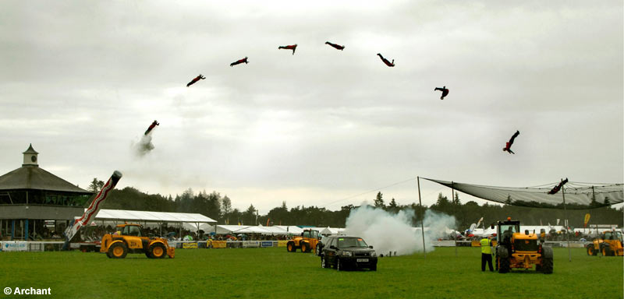
Human Cannonball
Isaac Carluccio and Kelly Pitner

Slide 2
Given:
Our engineering team has chosen a 45 degree angle of release because the initial vertical and horizontal velocities will be the same.
Our firing velocity is below the amount that would kill someone, but plenty high enough to have the biggest thrill. Therefore, we have chosen a velocity of 40 m/s.
In order to make sure the human cannonball is safe, the human will soar out of the cannon, through a blazing hoop correctly placed and land in the safety net two meters above the ground to ensure that there are minimal injuries throughout the entire flight.

Slide 3
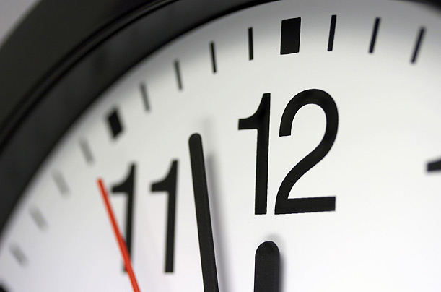
Calculations:
Time overall:
yf = yi +Viy(t) + ½(-9.8)(t^2)
2 = 0 + 40sin(45)(t) - 4.9t^2
0 = -4.9(t^2) + 28(t) - 2
(Use Quadratic Formula)
A = -4.9 B = 28 C = -2
T = 6 seconds

Slide 4
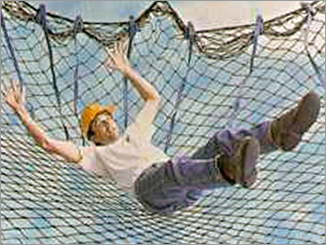
Calculations:
Distance for Safety Net:
Initial Velocity in the horizontal = 40cos(45) =28m/s
Time=6s
Vx= delta x/ delta t
Vx * delta t = delta x
28 * 6 = delta x
Delta x = 168 meters

Slide 5
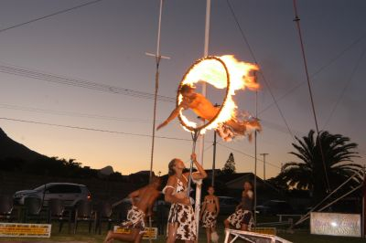
Calculations:
Time where human cannonball would pass through hoop or peak of trajectory:
Vfy = Viy + (-9.8)t where Vfy is the peak of the trajectory therefore Vfy = 0 m/s
(Vf – Vi)/a = time at peak
(0-28)/-9.8 = time at peak
Time at peak = 2.9 seconds

Slide 6
Calculations:
Placement of hoop:
You would use Vx = delta x / delta t
Vx * delta t = delta x or placement of the hoop
28 * 2.9 = delta x
Delta x = 81 meters
Height of hoop:
Vfy^2 = Viy^2 + 2(a)(delta y)
Vfy^2 – Viy^2 / 2(a) = delta y where Vfy = 0 m/s at peak
-28^2 / 2(-9.8) = delta y
Delta y = 40 meters

Slide 7
Proposal:
When firing the human cannonball at 40 m/s at an angle of 45 degrees, we determined the human cannonball would pass through the blazing hot hoop at 2.9 seconds while 40 meters in the air at a position 81.2 meters from the cannon. Continuing to the safety net 3.1 seconds later approximately 86 meters further from where he passed through the hoop. To the crowd, this will look completely effortless since all the calculations and work is already done for you. For the most amazing, thrilling, and eye-popping event, we believe our product is the one for you!

Slide 8
